Slide 1
Host Configuration:
BOOTP and DHCP

Slide 2
Introduction
Information needed by a computer that uses TCP/IP protocol suite:
  IP Address
  Subnet mask
  IP address of default router
  IP address of name server
Previous protocols:
  RARP
  BOOTP

Slide 3
BOOTP
The Bootstrap Protocol (BOOTP) is a client/server protocol that configures a diskless computer or a computer that is booted for the first time. BOOTP provides the IP address, net mask, the address of a default router, and the address of a name server.
BOOTP is a static configuration protocol.

Slide 4
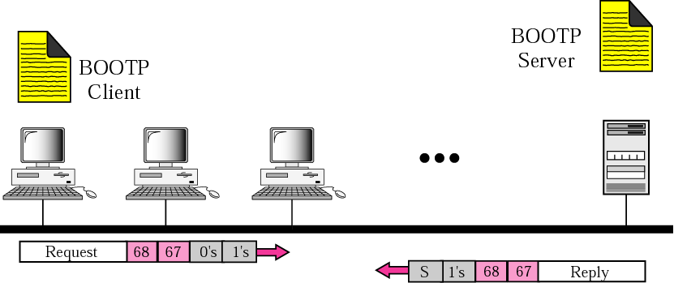
Figure 16.1 Client and server on the same network

Slide 5
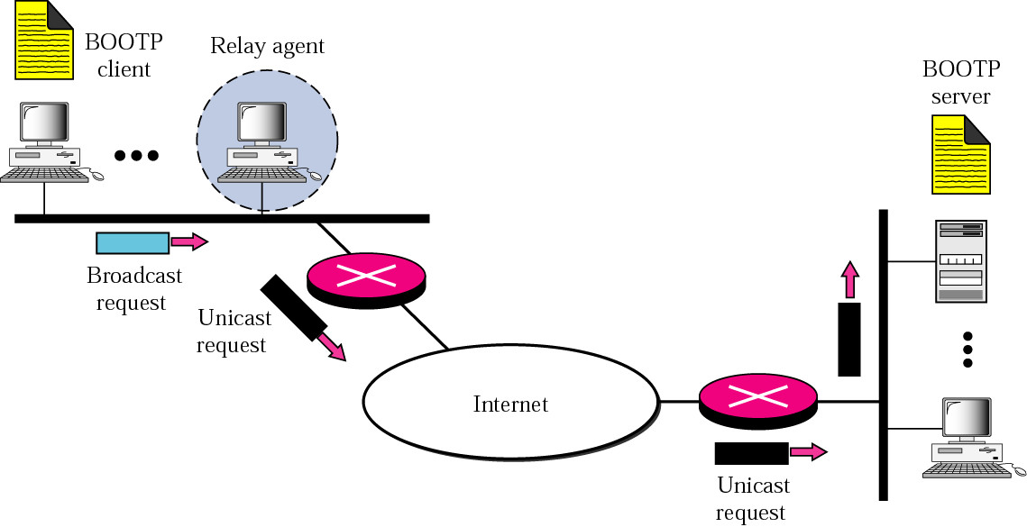
Figure 16.2 Client and server on two different networks
TCP/IP Protocol Suite

Slide 6
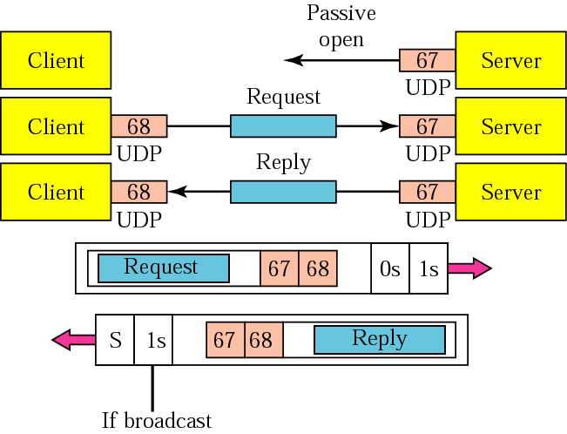
Figure 16.3 Use of UDP ports
TCP/IP Protocol Suite

Slide 7
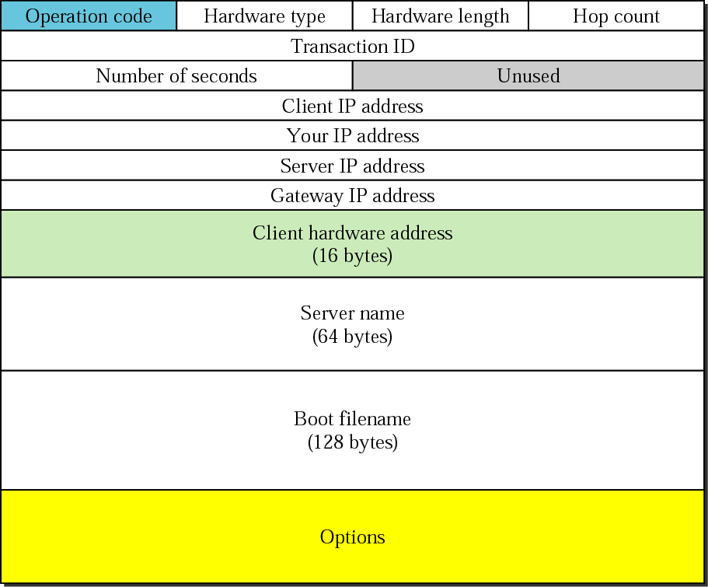
Figure 16.4 BOOTP packet format
TCP/IP Protocol Suite

Slide 8
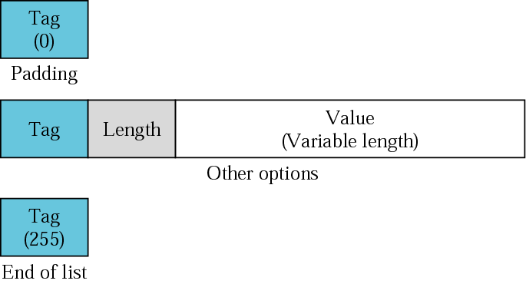
Figure 16.5 Option format
TCP/IP Protocol Suite

Slide 9
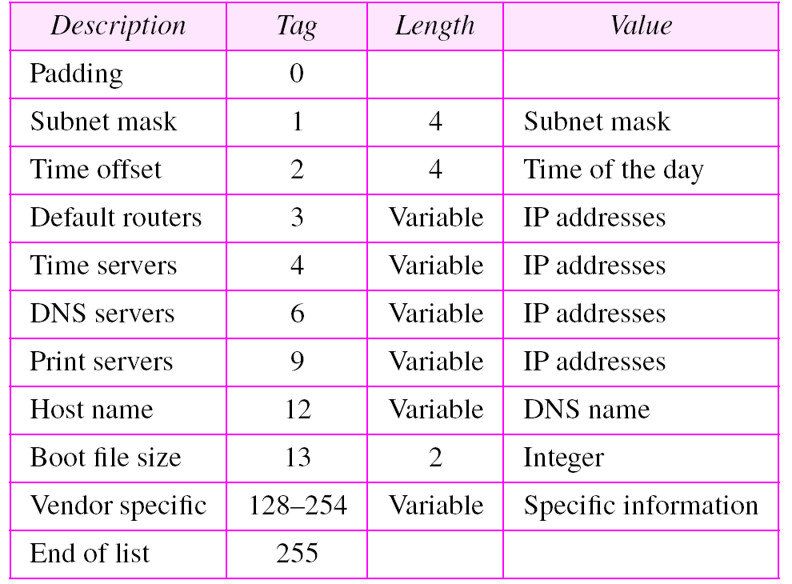
Table 16.1 Options for BOOTP
TCP/IP Protocol Suite

Slide 10
DHCP
The Dynamic Host Configuration Protocol (DHCP) provides static and dynamic address allocation that can be manual or automatic.
DHCP is successor to BOOTP and is backward compatible.
DHCP server can be on same network or different network.

Slide 11
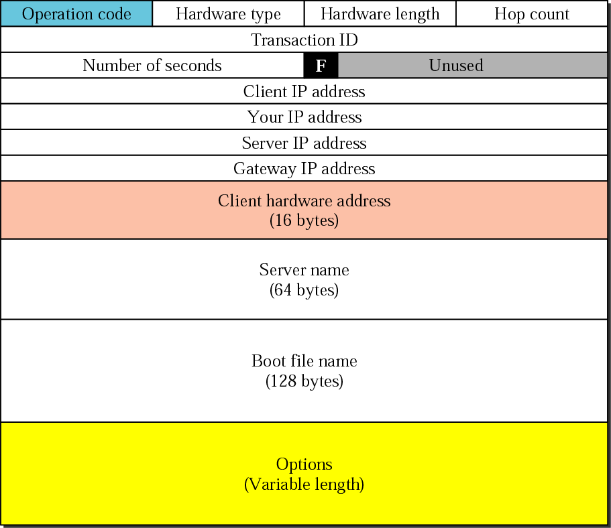
Figure 16.6 DHCP packet
TCP/IP Protocol Suite

Slide 12
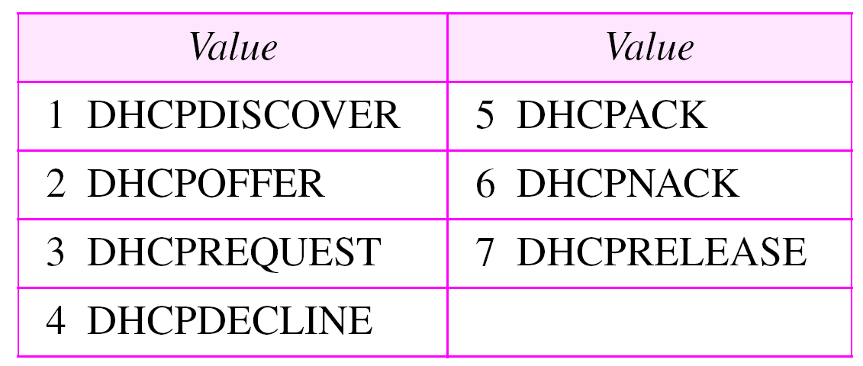
Table 16.2 Options for DHCP
TCP/IP Protocol Suite

Slide 13
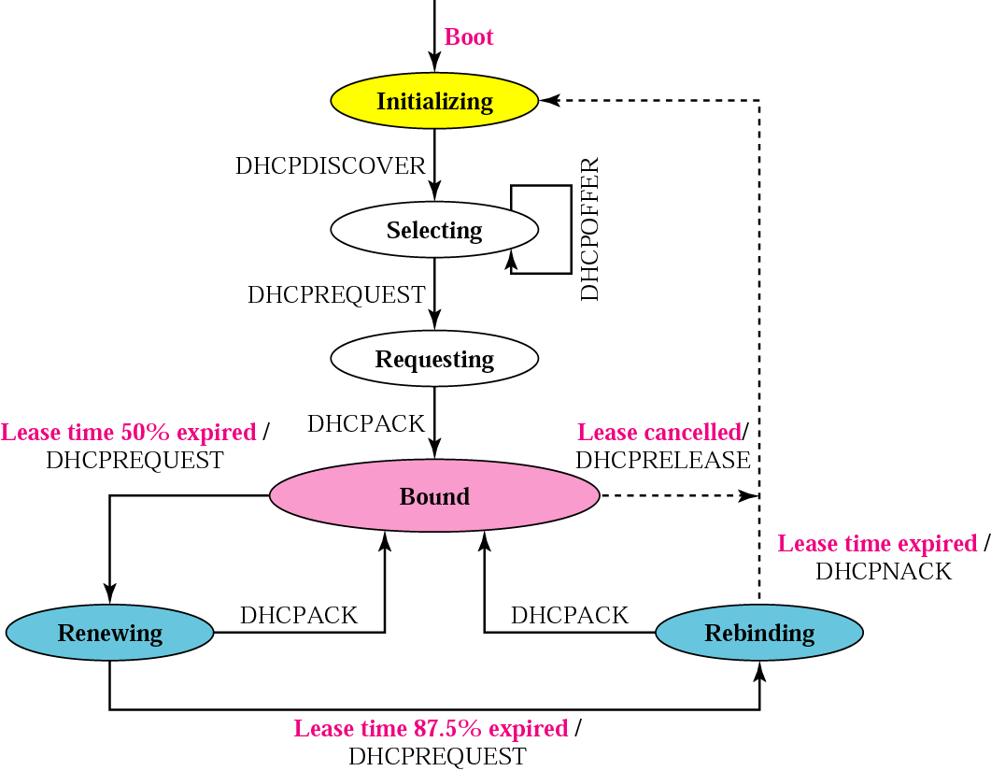
Figure 16.7 DHCP transition diagram
TCP/IP Protocol Suite

Slide 14
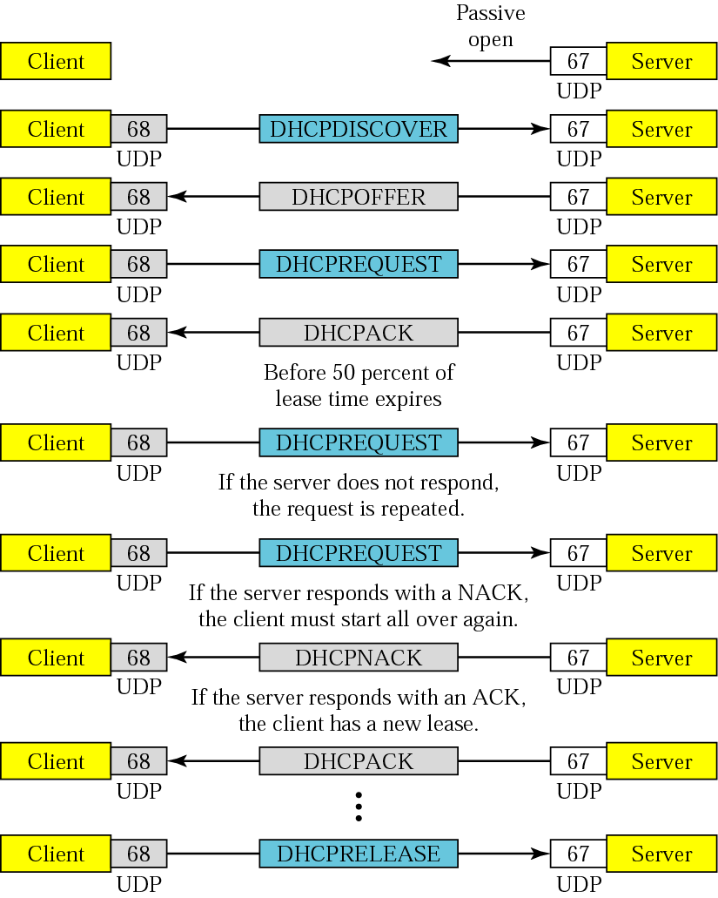
Figure 16.8 Exchanging messages
TCP/IP Protocol Suite

